Slide 1

“Secure Cloud Storage To Farm Data”
Project Presentation
MITU23BTCSD124 :- Pranjali Kulkarni
MITU23BTCSD065:-Shivraj Yadav
MITU23BTCSD040 :-Om Kalbhor
MITU23BTCSD034 :- Mayur Magar
Guided by Prof. Aditya Pai H
Department of Computer Science & Engineering, MITSoC, Loni Kalbhor

Slide 2
Outline
Introduction
Problem Statement
Objectives
Concepts & Methods
Literature Review
Tools and Languages
Results
Conclusion and Future Work
Reference
Q&A
Department of Computer Science & Engineering, MITSoE, Loni Kalbhor

Slide 3
Introduction
In Modern agriculture Data play a crucial role in the Improving productivity and issued
Efficiency and SustainabilityFarmers today collect vast amounts of information .
.
The Managing and analyzing this growing volume of data requires reliable and scalable storage solutions .
Cloud offers an effective way to store, access, and share farm data securely over the internet .
Department of Computer Science & Engineering, MITSoE, Loni Kalbhor

Slide 4
Problem Statement
Farmers today generate vast amounts of data from sensors, drones, and weather systems.
Traditional storage methods are often limited, insecure, and difficult to access remotely.
This leads to data loss, poor analysis, and inefficient farm management decisions..
There is a growing need for a secure and scalable cloud storage solution to manage farm data effectively.
Objectives
To provide farmers with a secure and scalable cloud storage solution for efficient management and access of farm data.
Study to explore how cloud storage can be used to securely store, manage, and access farm data efficiently. It aims to provide farmers
scalable and reliable data storage solution that supports real-time decision-making. Additionally, it focuses on improving data sharing, reducing storage costs
enhancing the overall productivity of agricultural operations through cloud-based technologies.
Department of Computer Science & Engineering, MITSoE, Loni Kalbhor

Slide 5
1. Concepts and Methods
The Concept Cloud storage allows farmers to securely store data from sensors, drones, weather stations, and machinery on remote servers, enabling easy access, scalability, and real-time updates.
Farmers upload collected data to the cloud, manage it using secure access controls, and analyze it through cloud-based tools to make informed decisions for crop management, resource optimization, and productivity improvement.
Direct Cloud storage is a service that allows data to be stored on remote servers accessible via the internet instead of local storage devices.
It enables farmers to store large volumes of farm data securely and access it from anywhere.
Types of collected Data:
Soil quality and moisture levels
Weather and climate data
Crop growth and yield statistics
Department of Computer Science & Engineering, MITSoE, Loni Kalbhor

Slide 6
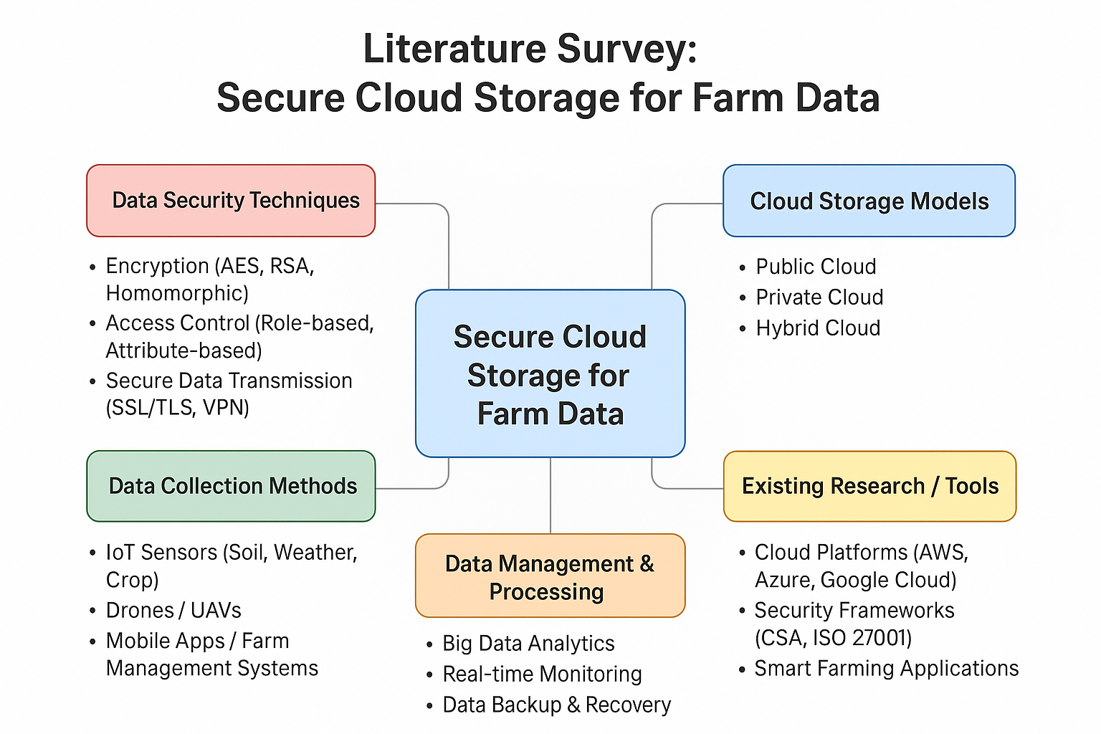
5. Literature Survey
Department of Computer Science & Engineering, MITSoE, Loni Kalbhor

Slide 7
2. Tools and Languages
Tools - Cloud Platforms
Amazon Web Services (AWS): Services like S3 for storage, EC2 for computing, and AWS IoT for sensor integration.
Frontend and API Integration - Build a simple frontend using React/HTML or Postman to test APIs
Firebase, AWS S3, or Azure Blob Storage - user authentication and access control rules.
SQL / NoSQL (MongoDB, Firebase FireStore): For structured and unstructured farm data storage.
Security Testing - RBAC (Role-Based Access Control) and cloud security
Department of Computer Science & Engineering, MITSoE, Loni Kalbhor

Slide 8
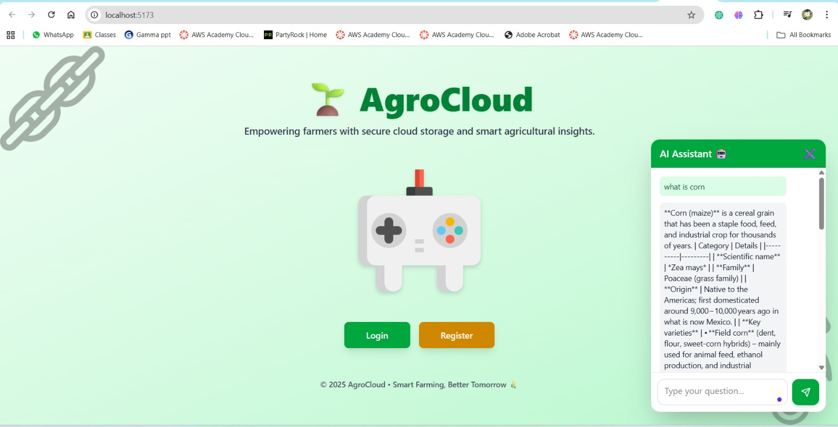
3. Results
Department of Computer Science & Engineering, MITSoE, Loni Kalbhor

Slide 9
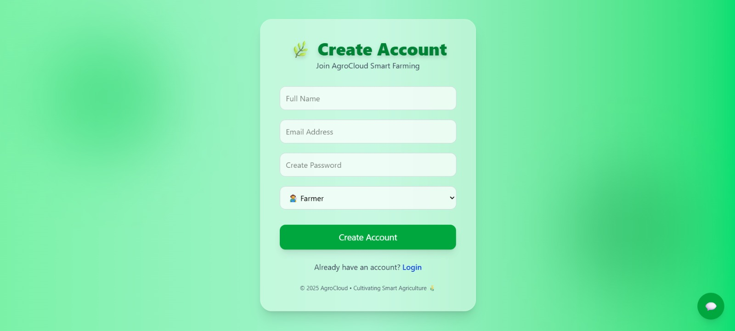

Slide 10
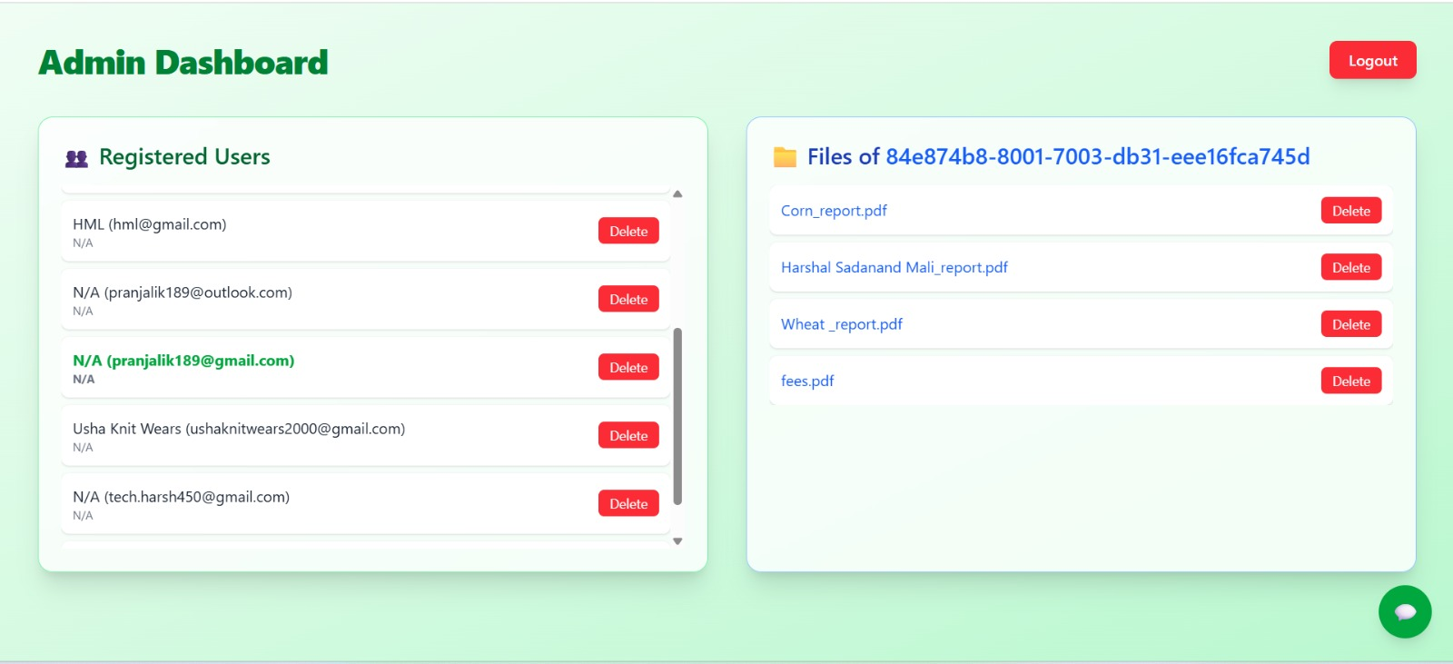

Slide 11
4. Conclusion and Future Work
Conclusion:
The Cloud storage provides a secure and scalable way to manage farm data.
It allows farmers to access information anytime and make data-driven decisions.
Integration with IoT and analytics improves productivity and resource efficiency.
Future Work:
The Future work can focus on integrating advanced AI and machine learning for predictive analytics.
make cloud data more accessible to small-scale farmers.
Enhanced security and blockchain-based solutions can further protect farm data and ensure transparency.
Department of Computer Science & Engineering, MITSoE, Loni Kalbhor

Slide 12
References
[1] Shekhar, S. (2025). Cloud Computing in Smart Agriculture: Data Storage, Processing, and Analysis.
[3] This paper explores how cloud computing facilitates scalable data storage, real-time monitoring, and predictive analytics in agriculture
[4] Kumar, V. (2024). A Comprehensive Review on Smart and Sustainable Agriculture. ScienceDirect.
The review discusses the integration of IoT, cloud computing .
Department of Computer Science & Engineering, MITSoE, Loni Kalbhor

Slide 13
Thank You
Department of Computer Science & Engineering, MITSoE, Loni Kalbhor

Slide 14
Questions
Department of Computer Science & Engineering, MITSoE, Loni Kalbhor

